Slide 1
Lecture 14 - While-Loops and Loop Invariants
while-loop, while-loop and conditions, loop invariants
Kok-Seng Wong | 2021

Slide 2

Motivation example 1
Keep going down the road until you see the gas station!
[source]

Slide 3

Motivation example 2

Slide 4
Learning outcomes
Upon the completion of this lecture, students will be able to:
understand the concept of while-loop.
describe the syntax for while-loop.
compare between for-loop and while-loop.
use while-loops for non-fixed repetition in code.

Slide 5
while-loop flowchart
condition
Entering while-loop
while test_expression:
Body of while
Test Expression
False
Statements after the while-loop
Statement(s)
True
Body of the while-loop

Slide 6
Flow of execution
Evaluate the condition, yielding 0 or 1.
If the condition is True (1), execute each of the statements in the body and then go back to step 1.
If the condition is False (0), exit the while statement and continue execution at the next statement.
Condition is True
while (condition):
do some instruction(s)
outside while-loop
Condition is False

Slide 7
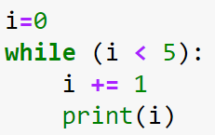
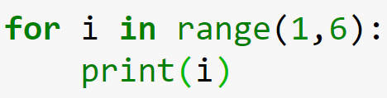

while-loop
while-loop: iterate over a block of code while the condition is true.
Indefinite iteration: Do something an unknown number of times.
condition
Equivalent to
counter
statements

Slide 8
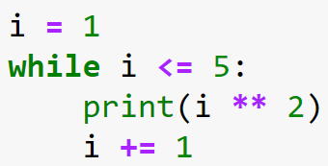
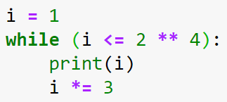


While-loop example 1
Case 1:
Case 2:

Slide 9
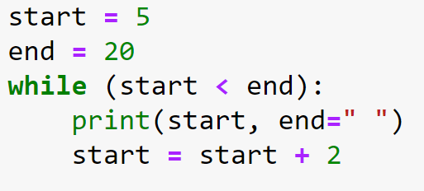

While-loop example 2
To append space instead of newline.

Slide 10
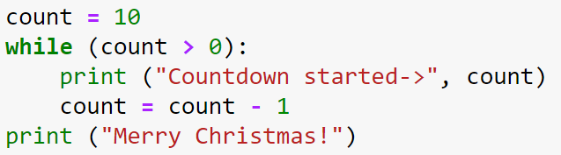
Class practice

Slide 11
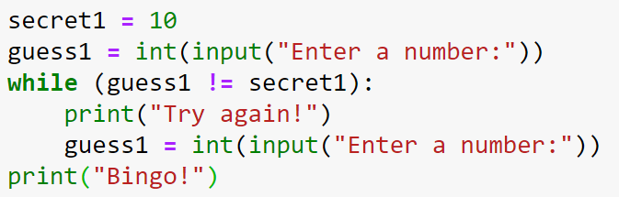
Class practice

Slide 12
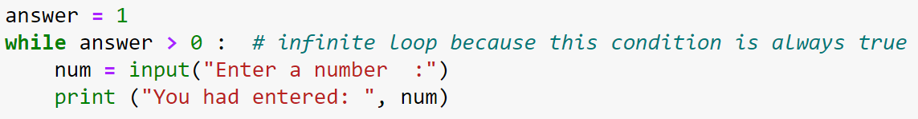
The Infinite loop
A loop becomes infinite loop if a condition never becomes FALSE.
The body of the loop should change the value of one or more variables so that eventually the condition becomes false and the loop terminates.
How to deal with an infinite loop?

Slide 13
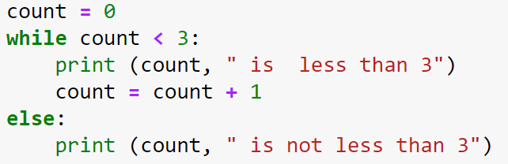
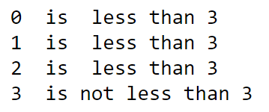
Using else Statement with While Loop
Python supports to have an else statement associated with a loop statement, e.g., if-else and while-else.
The else statement is executed when the condition becomes false.

Slide 14
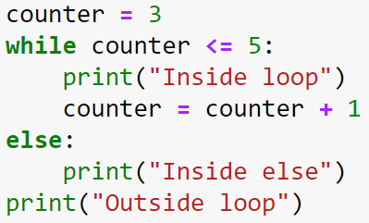
Class practice

Slide 15
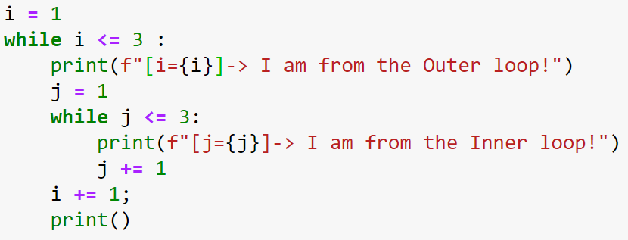
Nested while-loop
The use of a while-loop inside another while-loop.
outer while-loop
while test_expression:
while test_expression:
statement(s)
statement(s)
inner while-loop
What is the output?

Slide 16
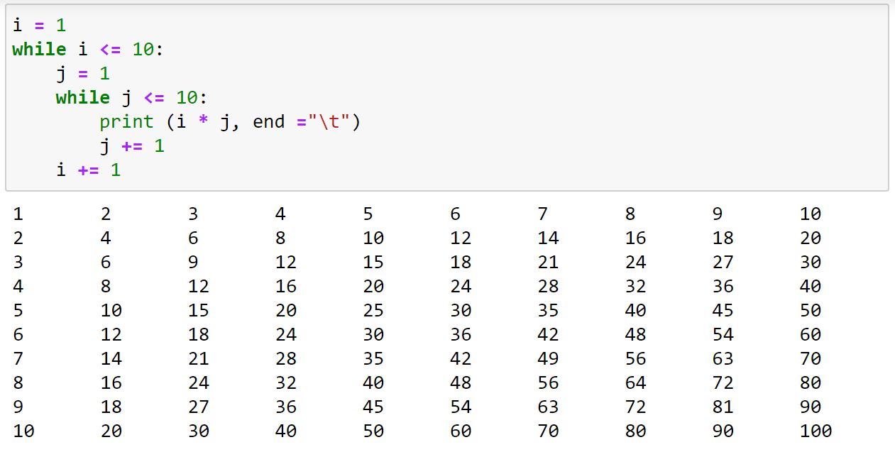
Nested while-loop: Multiplication table

Slide 17
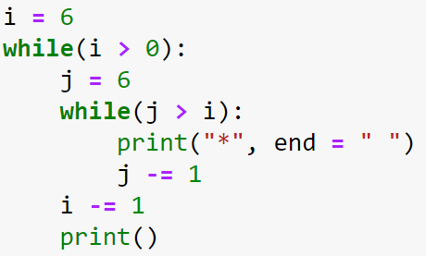
Class practice

Slide 18
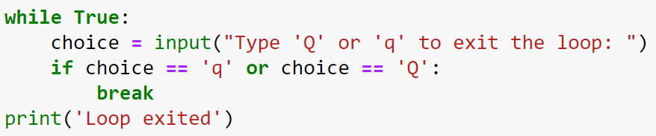

While-loop and conditions
condition

Slide 19
For-loop vs while-loop
For-loop
While-loop
i = 0
while i < n:
# do something
i = i + 1
for i in range(n):
# do something
Increment (Important!)

Slide 20
Group activity (1/2)
Observe the sample outputs in the next slide.
What is the possible problem set?
Discuss with your group members all possible checking steps/rules to validate the user’s input.
Write a complete program (in jupyter).

Slide 21

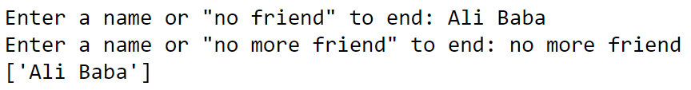
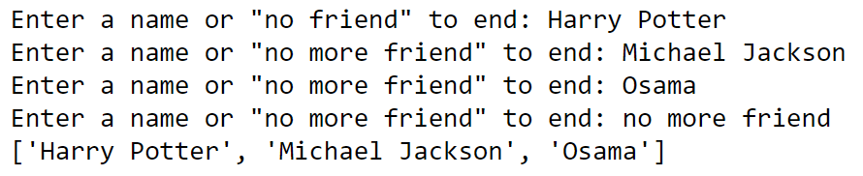
Group activity (2/2)
Case 1:
Case 2:
Case 3:

Slide 22
Loop invariants
Definition: a statement about program variables that is true before and after each iteration of a loop.
A good loop invariant should satisfy the following properties:
Initialization: The loop invariant must be true before the first execution of the loop.
Maintenance: If the invariant is true before an iteration of the loop, it should be true also after the iteration.
Termination: When the loop is terminated the invariant should tell us something useful, something that helps us understand the algorithm.

Slide 23
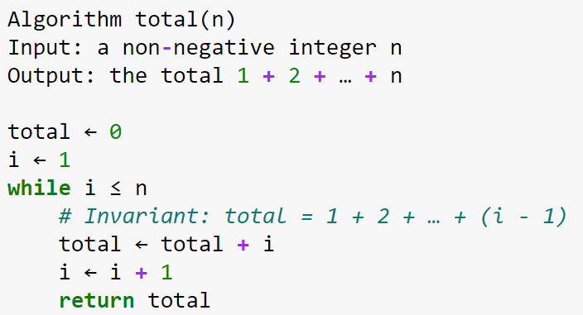
Loop invariant: example 1
The loop invariant holds initially since total = 0 and i = 1 at this point
Assuming the invariant holds before the i-th iteration, it will be true also after this iteration since the loop adds i to the total, and increments i by 1
When the loop is just about to terminate, the invariant states that total = 1 + 2 + … + n

Slide 24
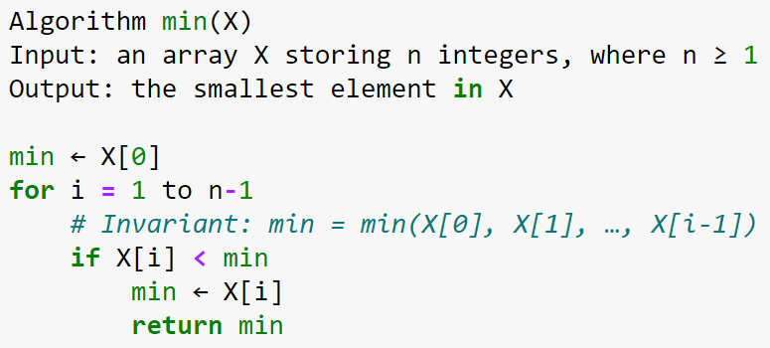
Loop invariant: example 2
The loop invariant holds initially since we let min = X[0] and start the loop with i = 1
Assuming the invariant holds before the i-th iteration, it will be true also after this iteration since the loop set the smallest value into min, and increments i by 1
When the loop is just about to terminate, the invariant states that
min = min(X[0], X[1], …, X[i-1])

